Slide 1
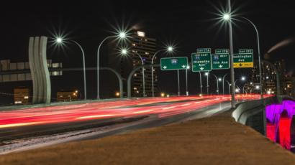
SPARKLING STARS FOR SMART CITIES….
PRESENTED BY:
P.BHAVYA SRI-187Y1A05C7
A.BHAGYA REKHA-187Y1A05C6
M.NEHA-187Y1A05E6
K.RAVALIKA-187Y1A05F2

Slide 2
OBJECTIVE
The main objective of this project is to utilize the application of the Arduino board to control the intensity of street lights.
Based on the intensity of outside light conditions LED glows according to suitable intensity.
Sometimes we forget to turn Off the lights and waste electricity and you must have also seen street light turned on in the day, so through this project we can turn off automatically if it is bright outside and turn ON if it is dark outside.
This process repeats everyday accordingly.

Slide 3
PROPOSED SYSTEM
Proposed system is that we can turn off lights automatically if it is bright outside and turns ON if it is dark outside.
But this time, in this circuit we are not only turning On and off lights based on light conditions but also varying the intensity of light according to outside light conditions.
Here we have used LDR and PWM concept with Arduino for decreasing or increasing the brightness of the 1 watt Power LED automatically.

Slide 4
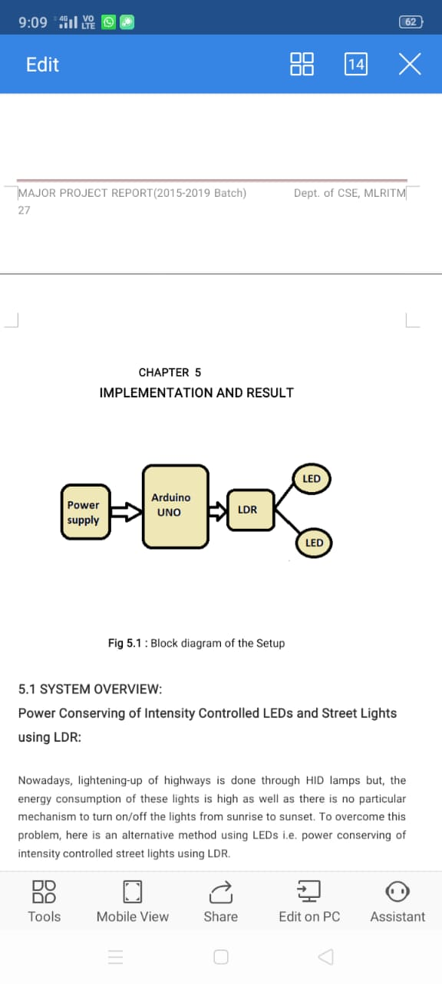
BLOCK DIAGRAM
Series of Operations performed:
Power is supplied through
adapter or any voltage
Device to Arduino.
LDR controls the intensity.
LED glows or glows off
Based on the intensity.

Slide 5
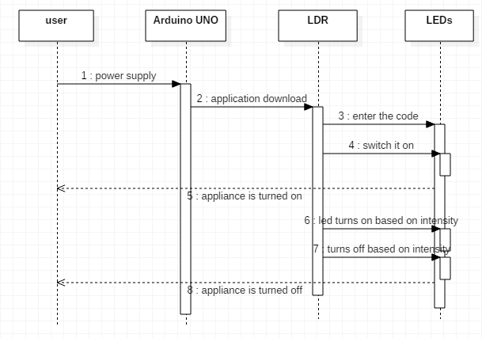
SEQUENCE DIAGRAM

Slide 6
HARDWARE AND SOFTWARE
HARDWARE:
1.Arduino
2.LDR
3.HC-05 Bluetooth Module
4.Adapter
5.LED
SOFTWARE:
1.A Programming Language
2.An Operating System

Slide 7
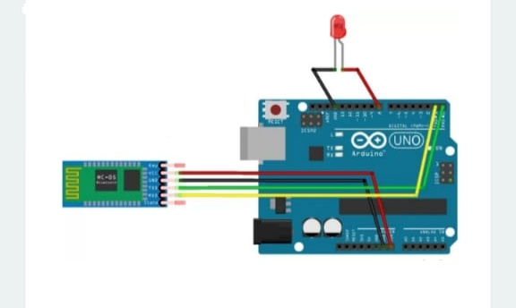
CIRCUIT DIAGRAM

Slide 8
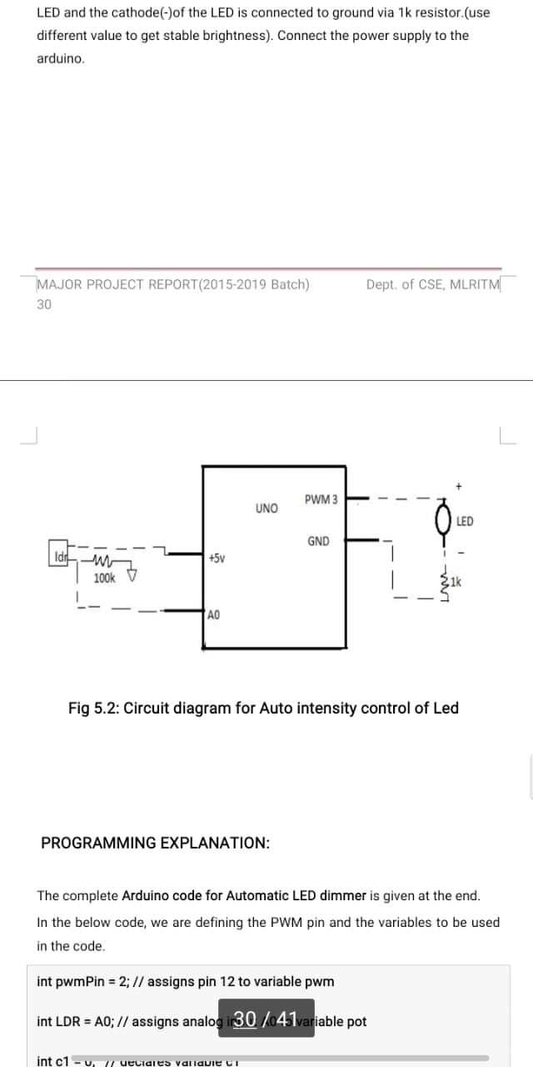
CIRCUIT CONNECTIONS
Arduino 3rd pin is connected to LED +ve.
Arduino GND is connected to LED – ve through 4.7k.
Arduino + 5v is connected to one end of LDR.
Arduino A0 pin is connected to LDR another end .
Arduino GND is connected to LDR another end with 4.7k.

Slide 9
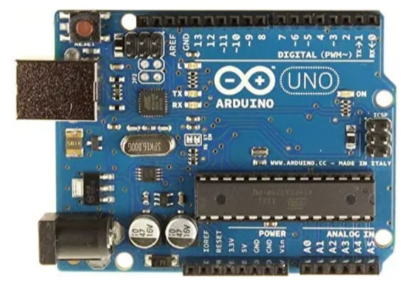
MODULES
Arduino Board:
The Arduino uno is one kind of microcontroller board based on ATmega328.The ATmega328 is a single-chip microcontroller created by Atmel and it is having Harvard architecture 8-bit RISC processor core.

Slide 10
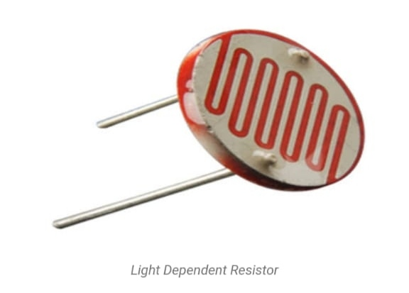
LDR(Light Dependent Resistor):
LDR is a sensor which is used to detect the intensity of the atmosphere light and changes its resistance depending upon the intensity of the light in the atmosphere.
The working principle behind the LDR is photoconductivity.
LDR is also called as Photocell, Photoconductor ,Photo resistor.

Slide 11
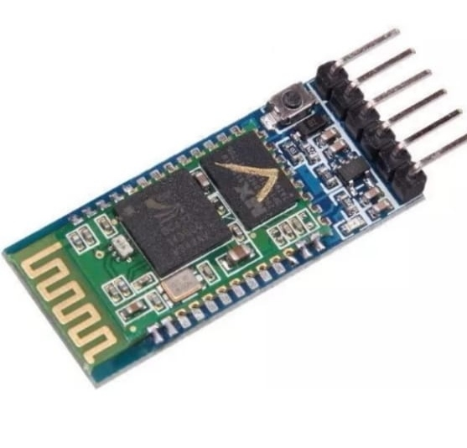
BLUETOOTH:
HC-05 Bluetooth module is designed for the wireless communications. It can be used in a slave or master configuration.
Bluetooth serial modules allow all the serial enabled devices to communicate with each other using Bluetooth.

Slide 12
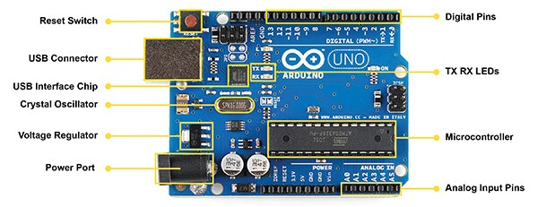
PARTS IN MODULES
1.Arduino UNO:
Power USB: USB cable is used to power Arduino board.
Voltage Regulator: Voltage Regultor is used to control the voltage inclined to Arduino board.
Crystal Oscillator: Crystal oscillator guides the Arduino to calculate and adjust the time.
TX and RX LEDs: The TX(Transmit) and RX( Recieve) LEDs are used to transmit and receive TTL serial data from Main micro controller:

Slide 13
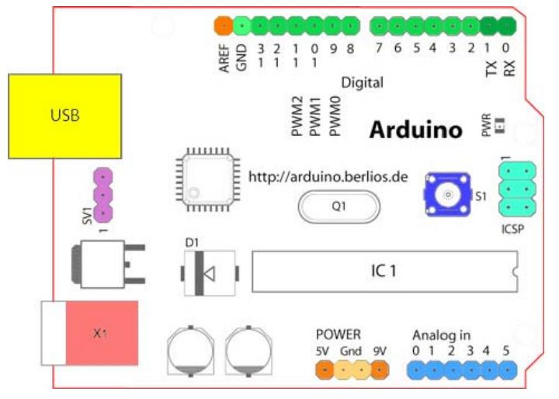
Main microcontroller:
->Microcontroller is Embedded within Arduino to control the features or actions of Arduino UNO board.
->It gathers the input from the sensor and send the signals to different parts.
Digital I/O and analog pins:
->Digital I/O pins are used to grasp the input logical values i.e. 0 or 1.
->Analog pins are used to read the analog signal from the analog sensor and transform it into digital.

Slide 14
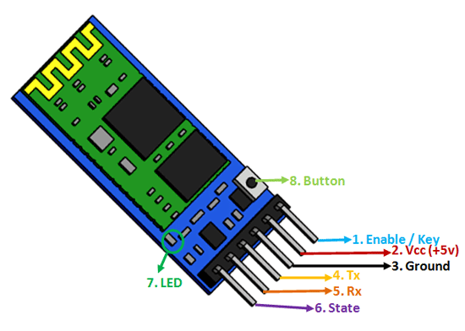
2.HC-05 Bluetooth Module:
1. Key/EN: It is used to bring the Bluetooth module in AT commands mode. If Key pin is set to high, then this module will work in command mode. Otherwise by default it is in data mode.
2. VCC: In our project we have connected 3.3V to VCC but in general we can connect either 5 V or 3.3 V to this Pin.
3. GND: Ground Pin of module.
4. TXD: TXD means Transmit Serial data. Whatever the data is received by the Bluetooth wirelessly will be transformed serially to TXD pin.
5. RXD: Receive data serially (received data will be transmitted wirelessly by this Bluetooth module).
6. State: State pin is used to check whether the Bluetooth is connected properly or not.

Slide 15
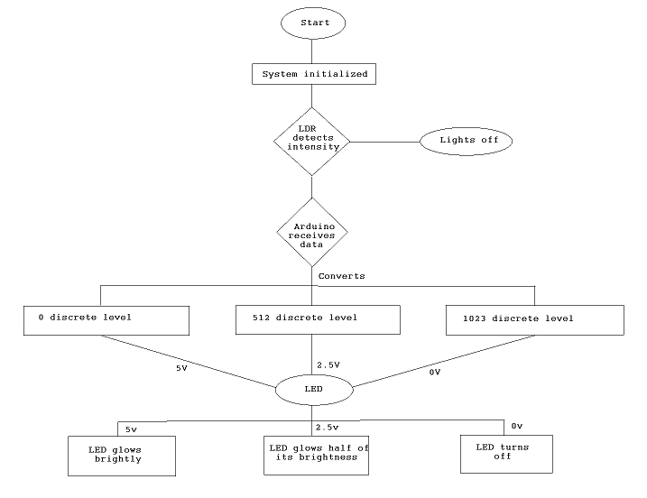
FLOW CHART

Slide 16
CODE
int pwmPin = 12; // assigns pin 12 to variable pwmPin
int pot = A0; // assigns analog input A0 to variable pot
int c1 = 0; // declares variable c1
int c2 = 0; // declares variable c2
void setup() // setup loop
{
pinMode(pwmPin, OUTPUT);
pinMode(pot, INPUT);
Serial.begin(9600);
}
void loop()
{
int value = analogRead(pot);

Slide 17
int value = analogRead(pot);
Serial.println(value);
c1= value;
c2= 500-c1; // subtracts c1 from 500 and saves the result in c2
if (value < 500) {
digitalWrite(pwmPin, HIGH);
delayMicroseconds(c2);
digitalWrite(pwmPin, LOW);
delayMicroseconds(c1);
}
if (value > 500) {
digitalWrite(pwmPin,LOW);
}
}

Slide 18
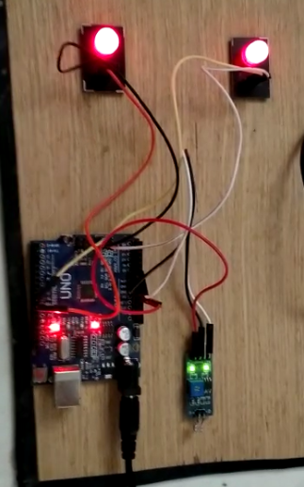
WORKING PROCEDURE
The working procedure of our model is very easier. In our project we use adapter to give supply. If at all we use any of the voltage devices then we have to use resistors, capacitors, transistors.

Slide 19
LDR -> Arduino ->LED
Arduino discret levels range = 0 to 1023
day time -> 1023 discret level -> 0v -> LED turns off
evening time -> 512 discret level -> 2.5v -> LED glows with half brightness
night time -> 0 discret level -> 5v -> LED glows brightly
Hence, the LED not only just automatically switches ON and OFF but also adjust the amount of light emitted according to the outside light condition.

Slide 20

CONCLUSION
->>In this “SPARKLING LIGHTS FOR SMART CITIES” an amazing alternative to conventional street lights as it is a great way to save power and reduce wastage.
->>the intensity of light varies according to outside light conditions.
->>We can use electricity efficiently
->>Since everthing is automated we can reduce electrical accidents
->> Maintance cost is also less since there is no manual switching

Slide 21

SCOPE
Our project can be enhanced by adding motion sensors like PIR, Ultrasonic, Microwave, Tomographic and other combined types.
So that we can save the electricity and also detect the motion of the pedestrians and vehicles,the rate of accidents can be decreased by using these motion sensors.
Also this automated system can be upgraded to detect the disrupted(failed) street light and send an alert message to the control department to take appropriate action by linking it with suitable sensors.
We can used in smart houses

Slide 22

REFERENCES
Wang Xiao-Yuan, Andrew L. Fitch, Herbert H. C. Iu, Victor Sreeramand Qi Wei-Gui “Implementation of an analogue model of a memristor based on a light-dependent resistor”2012 Chinese Physical Society and IOP Publishing Ltd Chinese Physics B, Volume 21, Number 10 International Journal of Engineering Research and General Science Volume 4, Issue 2, March- April, 2016 ISSN 2091-2730 790
A.A.Nippun Kumaar, Kiran.G, Sudarshan TSB,” Intelligent Lighting System Using Wireless Sensor Networks”, International Journal of Ad hoc, Sensor & Ubiquitous Computing (IJASUC) Vol.1, No.4, December 2010, pp 17-27
Y. K. Tan; T. P. Huynh; Z. Wang,” Smart Personal Sensor Network Control for Energy Saving in DC Grid Powered LED Lighting System”, IEEE Trans. Smart Grid.

Slide 23

O’Reilly, Fergus, and Joe Buckley. "Use of wireless sensor networks for fluorescent lighting control with daylight substitution." Proceedings of the Workshop on Real-World Wireless Sensor Networks (REANWSN). 2005.
Divya, Guddeti, et al. "Design and Implement of Wireless Sensor Street Light Control and Monitoring Strategy along with GUI." IJITR (2016): 78-81.
Prasetyo, William Tandy, Petrus Santoso, and Resmana Lim. "Adaptive Cars Headlamps System with Image Processing and Lighting Angle Control." Proceedings of Second International Conference on Electrical Systems, Technology and Information 2015 (ICESTI 2015). Springer Singapore, 2016.

Slide 24
THANK YOU

